Slide 1




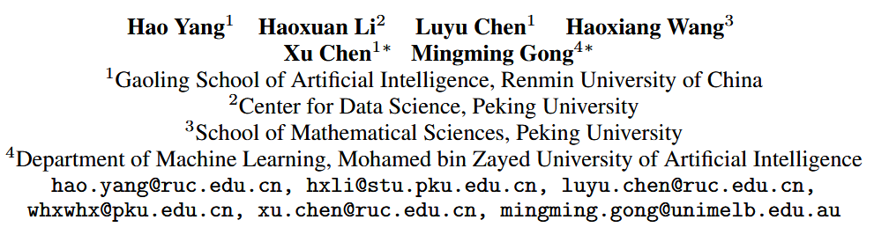





ATAI
Advanced Technique of Artificial Intelligence
ATAI
ChongqingUniversity _{AdvancedTechniqueof}
of Technology Artificial Intelligence
Chongqing University of
Technology
Chongqing University ^{ATAI}
_{of Technology} Advanced Techniqueof
Artificial Intelligence
Chongqing University of Technology
Chongqing University of Technology
Mitigating Hidden Confounding by Progressive Confounder Imputation via Large Language Models
Code : Nothing
——arXiv_2025
Reported by Yuhang Jang
1

Slide 2
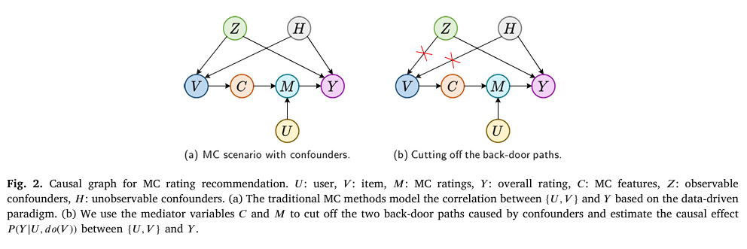
ATAI
Advanced Technique of Artificial Intelligence
ATAI
ChongqingUniversity _{AdvancedTechniqueof}
of Technology Artificial Intelligence
Chongqing University of
Technology
Chongqing University ^{ATAI}
_{of Technology} Advanced Techniqueof
Artificial Intelligence
Chongqing University of Technology
Chongqing University of Technology
Motivation
2026_Information Processing and Management_Causal inference for alleviating confounding bias in multi-criteria rating recommendation.

Slide 3
ATAI
Advanced Technique of Artificial Intelligence
ATAI
ChongqingUniversity _{AdvancedTechniqueof}
of Technology Artificial Intelligence
Chongqing University of
Technology
Chongqing University ^{ATAI}
_{of Technology} Advanced Techniqueof
Artificial Intelligence
Chongqing University of Technology
Chongqing University of Technology
Motivation
Existing methods including those based on LLMs, mostly rely on the unconfounded assumption , which posits that all confounders affecting both treatment and outcome are observed. This assumption is often unrealistic in real-world settings, where important factors may be unobserved or entirely unrecorded.

Slide 4
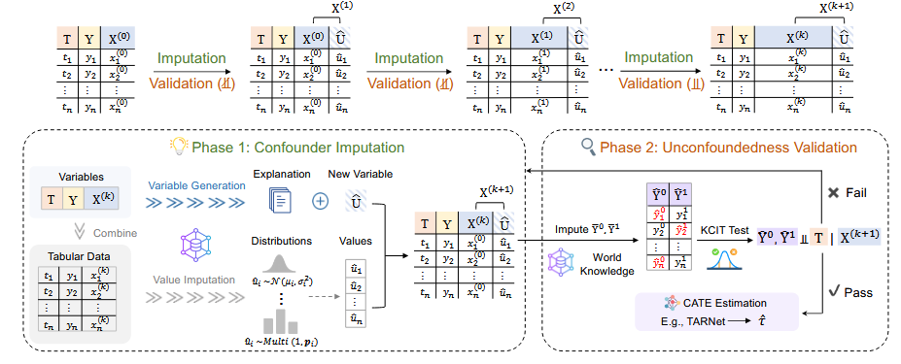
ATAI
Advanced Technique of Artificial Intelligence
ATAI
ChongqingUniversity _{AdvancedTechniqueof}
of Technology Artificial Intelligence
Chongqing University of
Technology
Chongqing University ^{ATAI}
_{of Technology} Advanced Techniqueof
Artificial Intelligence
Chongqing University of Technology
Chongqing University of Technology
Method
Notes:
得到反事实结果就是说，我如果没观测到就是我没推荐，那么打分是多少，可以理解他流行度这个因素取消了，那么他应该打多少分

Slide 5
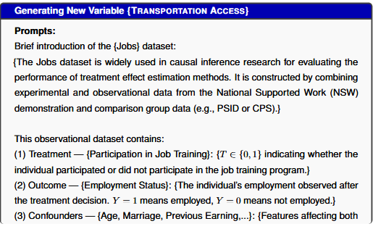
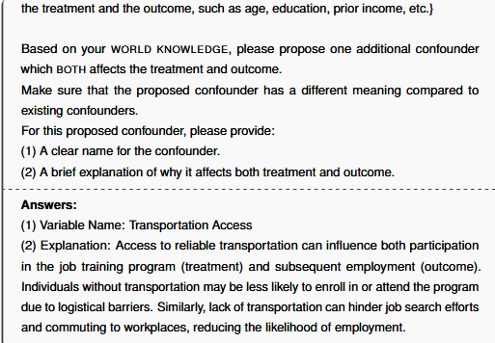
ATAI
Advanced Technique of Artificial Intelligence
ATAI
ChongqingUniversity _{AdvancedTechniqueof}
of Technology Artificial Intelligence
Chongqing University of
Technology
Chongqing University ^{ATAI}
_{of Technology} Advanced Techniqueof
Artificial Intelligence
Chongqing University of Technology
Chongqing University of Technology
Method
可靠的交通工具可及性会影响职业培训项目的参与度（治疗）和后续就业（结果）。 由于后勤障碍，没有交通工具的
个人可能更不愿意报名或参加该项目。同样，缺乏交通工具会阻碍求职和通勤，降低就业机会。

Slide 6
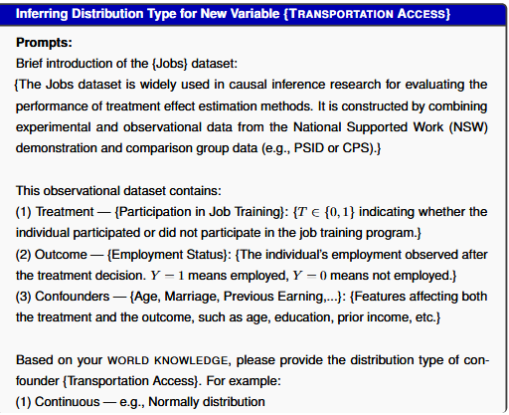
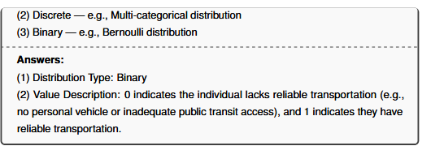
ATAI
Advanced Technique of Artificial Intelligence
ATAI
ChongqingUniversity _{AdvancedTechniqueof}
of Technology Artificial Intelligence
Chongqing University of
Technology
Chongqing University ^{ATAI}
_{of Technology} Advanced Techniqueof
Artificial Intelligence
Chongqing University of Technology
Chongqing University of Technology
Method

Slide 7
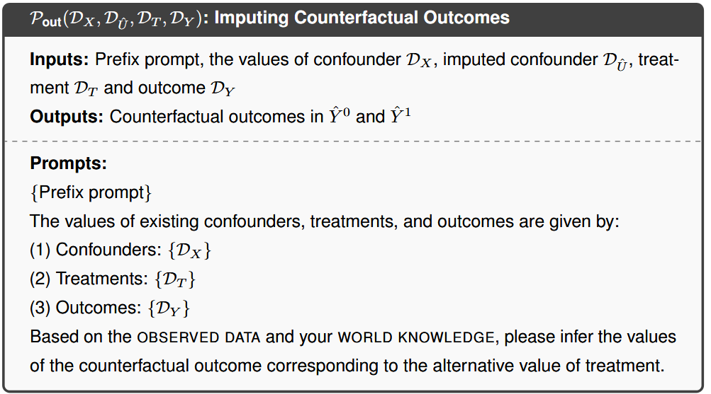
ATAI
Advanced Technique of Artificial Intelligence
ATAI
ChongqingUniversity _{AdvancedTechniqueof}
of Technology Artificial Intelligence
Chongqing University of
Technology
Chongqing University ^{ATAI}
_{of Technology} Advanced Techniqueof
Artificial Intelligence
Chongqing University of Technology
Chongqing University of Technology
Method

Slide 8
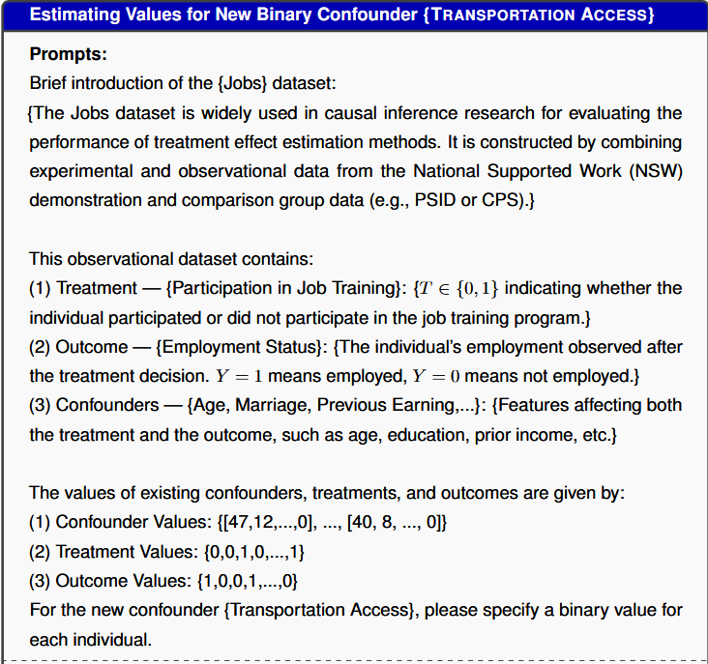
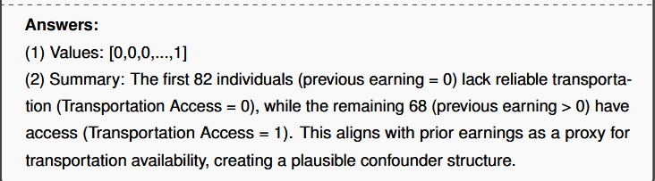
ATAI
Advanced Technique of Artificial Intelligence
ATAI
ChongqingUniversity _{AdvancedTechniqueof}
of Technology Artificial Intelligence
Chongqing University of
Technology
Chongqing University ^{ATAI}
_{of Technology} Advanced Techniqueof
Artificial Intelligence
Chongqing University of Technology
Chongqing University of Technology
Method
前82名（之前收入=0）缺乏可靠的交通工具（交通可及性=0），其余68名（之前收入>0）有交通可达性（交通可及性=1）。这与以往收益作为交通可用性的代理指标相符，形成了一个合理的混杂因素结构。

Slide 9

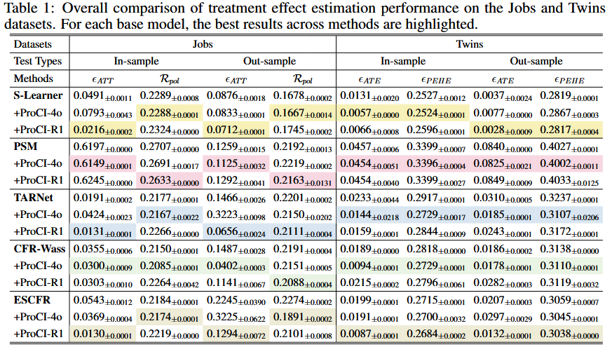
ATAI
Advanced Technique of Artificial Intelligence
ATAI
ChongqingUniversity _{AdvancedTechniqueof}
of Technology Artificial Intelligence
Chongqing University of
Technology
Chongqing University ^{ATAI}
_{of Technology} Advanced Techniqueof
Artificial Intelligence
Chongqing University of Technology
Chongqing University of Technology
Notes:
In-sample指的是在训练模型的数据集中进行测试，out-sample指的是没见过测试机的数据进行测试。在数据集中Twins里面是有反事实结果的，ATE是衡量两个指标的差绝对值，PEHE衡量的是预测的怎么样。对于Jobs数据集含有一个晓得随机对照实验

Slide 10
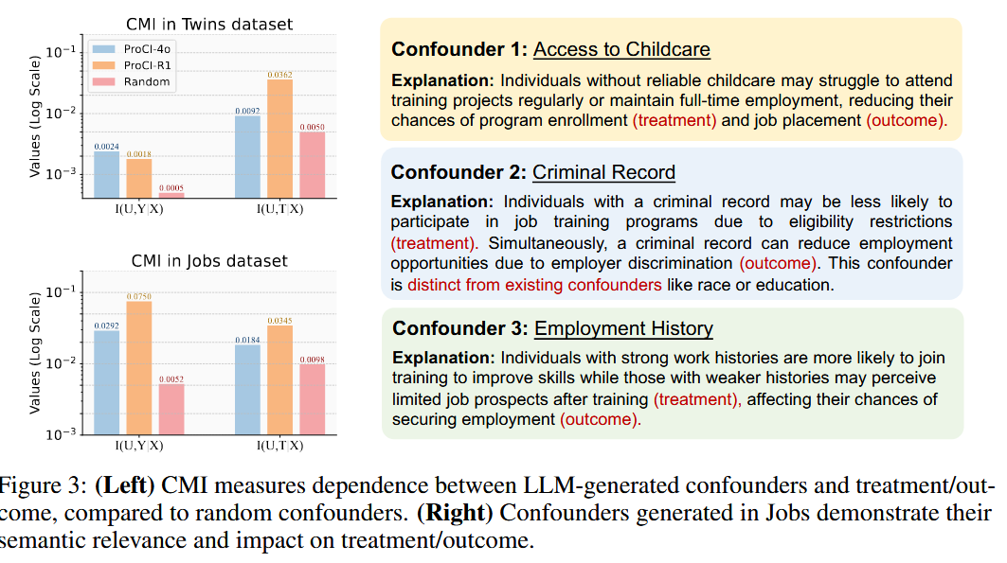
ATAI
Advanced Technique of Artificial Intelligence
ATAI
ChongqingUniversity _{AdvancedTechniqueof}
of Technology Artificial Intelligence
Chongqing University of
Technology
Chongqing University ^{ATAI}
_{of Technology} Advanced Techniqueof
Artificial Intelligence
Chongqing University of Technology
Chongqing University of Technology

Slide 11
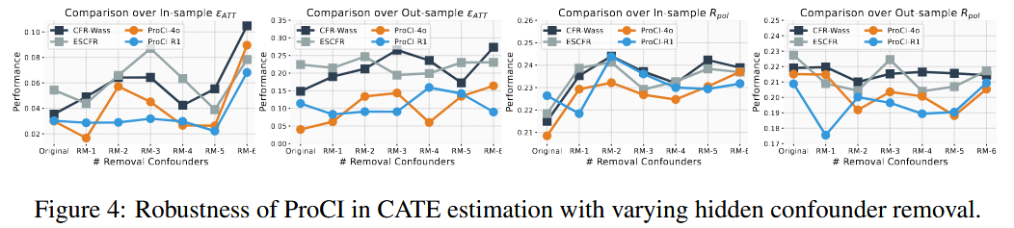
ATAI
Advanced Technique of Artificial Intelligence
ATAI
ChongqingUniversity _{AdvancedTechniqueof}
of Technology Artificial Intelligence
Chongqing University of
Technology
Chongqing University ^{ATAI}
_{of Technology} Advanced Techniqueof
Artificial Intelligence
Chongqing University of Technology
Chongqing University of Technology

Slide 12
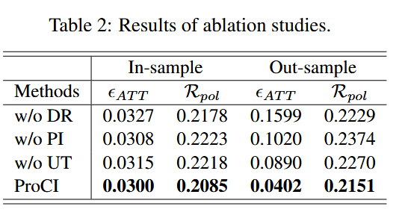
ATAI
Advanced Technique of Artificial Intelligence
ATAI
ChongqingUniversity _{AdvancedTechniqueof}
of Technology Artificial Intelligence
Chongqing University of
Technology
Chongqing University ^{ATAI}
_{of Technology} Advanced Techniqueof
Artificial Intelligence
Chongqing University of Technology
Chongqing University of Technology
Notes:
移除数据分布、移除不断产生混淆因子那个方法，移除验证混淆因素部分

Slide 13


ATAI
Advanced Technique of Artificial Intelligence
ATAI
ChongqingUniversity _{AdvancedTechniqueof}
of Technology Artificial Intelligence
Chongqing University of
Technology
Chongqing University ^{ATAI}
_{of Technology} Advanced Techniqueof
Artificial Intelligence
Chongqing University of Technology
Chongqing University of Technology
Thanks!

